Slide 1
METHODS OF ANALYSIS.
NODAL ANALYSIS.
In nodal analysis, we are interested in finding the node voltages.
Given a circuit with n nodes without voltage sources, the nodal analysis
of the circuit involves taking the following three steps.

Slide 2
S t e p s t o D e t e r m i n e Node V o l t a g e s :
1. Select a node as the reference node. Assign voltages v1, v2, . . . , vn−1 to the remaining n − 1 nodes. The voltages are referenced with respect to the reference node.
2. Apply KCL to each of the n − 1 non reference nodes. Use Ohm’s law to express the branch currents in terms of node voltages.
3. Solve the resulting simultaneous equations to obtain the unknown node voltages.

Slide 3
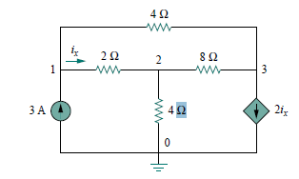

Examples.
1. Determine the voltages at the nodes in a circuit below. (apply nodal analysis) then obtain $i_{x}$

Slide 4
MESH ANALYSIS.
The quit difference between Nodal analysis and Mesh circuit analysis is that, Nodal analysis applies KCL to find unknown voltages in a given circuit, while mesh analysis applies KVL to find unknown currents.
Mesh analysis is not quite as general as nodal analysis because it is only applicable to a circuit that is planar.
A planar circuit is one that can be drawn in a plane with no branches crossing one another; otherwise it is nonplanar.
A circuit may have crossing branches and still be planar if it can be redrawn such that it has no crossing branches.

Slide 5
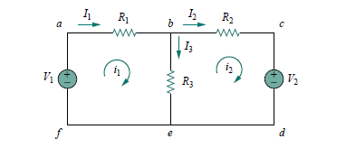
What is the Mesh ?
A mesh is a loop which does not contain any other loops within it.
For example consider a circuit below.
A, paths abefa and bcdeb are meshes, but path
abcdefa is not a mesh.
The current through a mesh is known as mesh
current. In mesh analysis, we are interested in applying KVL to find the mesh currents in a given circuit.

Slide 6
S t e p s t o D e t e r m i n e Mesh C u r r e n t s
1. Assign mesh currents i1, i2, . . . , in to the n meshes.
2. Apply KVL to each of the n meshes. Use Ohm’s law to express the voltages in terms of the mesh currents.
3. Solve the resulting n simultaneous equations to get the mesh currents.

Slide 7
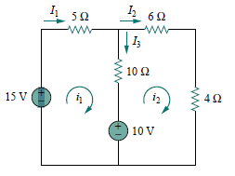

.Example.
2.For the circuit in Fig. below, find the branch currents $I_{1}$, $I_{2}$, and $I_{3}$ using mesh analysis.

Slide 8
CIRCUIT THEOREMS.
The growth in areas of application of electric circuits has led to an evolution from simple to
complex circuits.
To handle the complexity, engineers over the years
have developed some theorems to simplify circuit
analysis. Such theorems include Thevenin’s and
Norton’s theorems.
Since these theorems are applicable to linear
circuits, we first discuss the concept of circuit
linearity.

Slide 9
LINEARITY PROPERTY.
Linearity is the property of an element describing a linear relationship between cause and effect
Although the property applies to many circuit elements, we shall limit its applicability to resistors in this lecture.

Slide 10
What is a linear circuit?
A linear circuit is one whose output is linearly related (or directly proportional) to its input.

Slide 11
SUPERPOSITION;
If a circuit has two or more independent sources,
one way to determine the value of a specific
variable (voltage or current) is to use nodal or
mesh analysis as in lecture 03.
Another way is to determine the contribution of each independent source to the variable and then add them up. This approach is known as the superposition.

Slide 12
The superposition principle states that “The voltage across (or current through) an element in a linear circuit is the algebraic sum of the voltages across (or currents through) that element due to each independent source acting alone”

Slide 13
S t e p s t o A p p l y S u p e r p o s i t i o n P r i n c i p l e .
1.Turn off all independent sources except one source. Find the output (voltage or current) due to that active source using nodal or mesh analysis.
2.Repeat step 1 for each of the other independent sources.
3.Find the total contribution by adding algebraically all the contributions due to the independent sources.

Slide 14

Example
1.Use the superposition theorem to find v in the circuit in Fig below.

Slide 15
THEVENIN’S THEOREM.
It often occurs in practice that a particular
element in a circuit is variable (usually called the
load) while other elements are fixed. As a typical
example, a household outlet terminal may be
connected to different appliances constituting a
variable load. Each time the variable element is
changed, the entire circuit has to be analyzed all
over again. To avoid this problem, Thevenin’s
theorem provides a technique by which the fixed
part of the circuit is replaced by an equivalent
circuit.

Slide 16
Thevenin’s theorem states that a linear two-terminal circuit can be replaced by an equivalent circuit consisting of a voltage source VTh in series with a resistor RTh, where VTh is the open-circuit voltage at the terminals and RTh is the input or equivalent resistance at the terminals when the independent sources are turned off.

Slide 17
A linear circuit with a variable load can be replaced
by the Thevenin equivalent, exclusive of the load. The equivalent network behaves the same way externally as the original circuit. Consider a linear circuit terminated by a load RL, as shown in circuit(a).
The current IL through the load and the voltage VL across the load are easily determined once the Thevenin equivalent of the circuit at the load’s terminals is obtained, as shown in circuit(b).

Slide 18
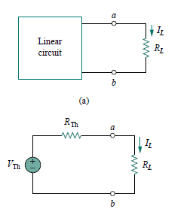

Slide 19

Mathematically.
$I_{L}$ = $\frac{V_{TH}}{R_{TH}+R_{L}}$.
$V_{L}$ = $I_{L}$ $R_{L}$.
Hence, $V_{L}$ = $\frac{V_{TH}}{R_{TH}+R_{L}}R_{L}$.

Slide 20
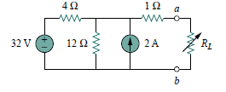
Example
02 Find the Thevenin equivalent circuit of the circuit shown below, to the left of the terminals a-b. Then find the current through RL = 6, 16, and 36 Ohms.

Slide 21
………..GOOD LUCK………
THE END OF LECTURE four.

